Slide 1
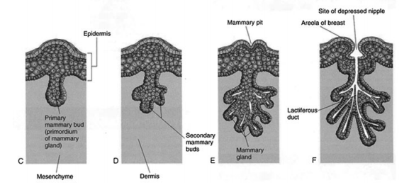
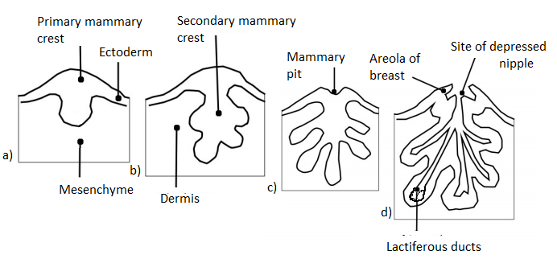
Epidermis
Dermis
mesenchyme
Lactiferous ducts

Slide 2
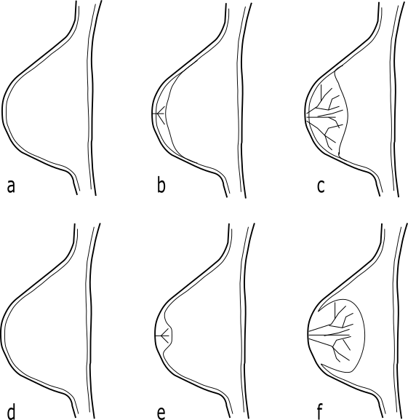
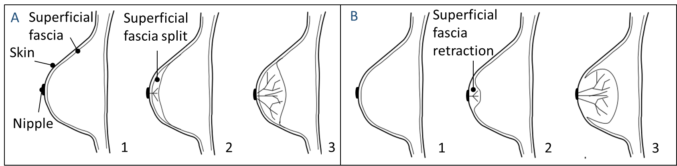
A
Superficial
fascia
Superficial
fascia split
B
Superficial
fascia
retraction
Skin
Nipple
1
2
3
1
2
3

Slide 3
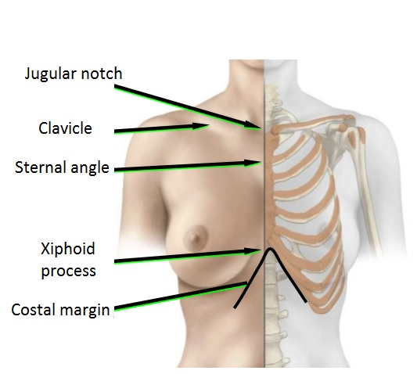
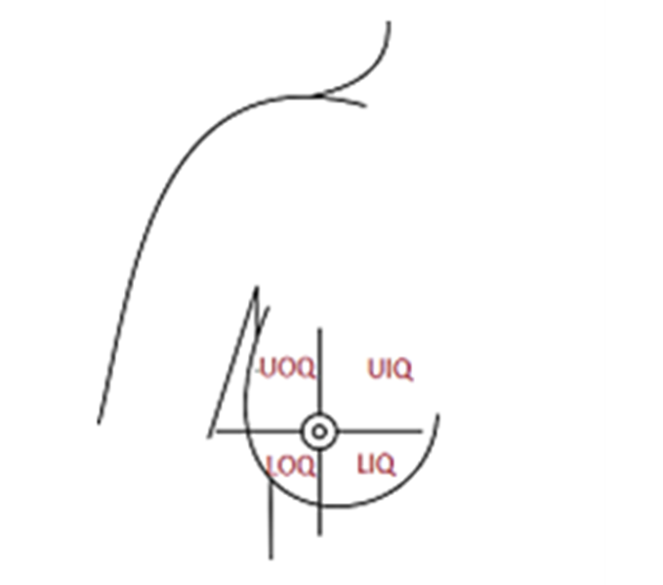

Slide 4
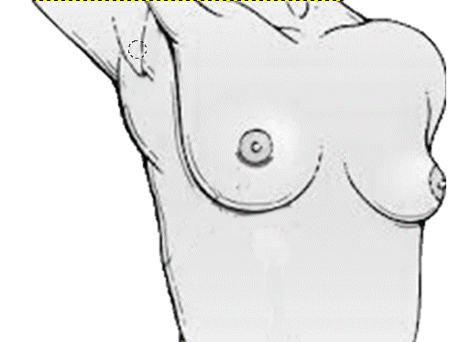
Clavicle
Sternal angle
Sternal line
Posterior axillary line
Costal margin
Midaxillary line
Inframammary
ligament
Anterior axillary line

Slide 5
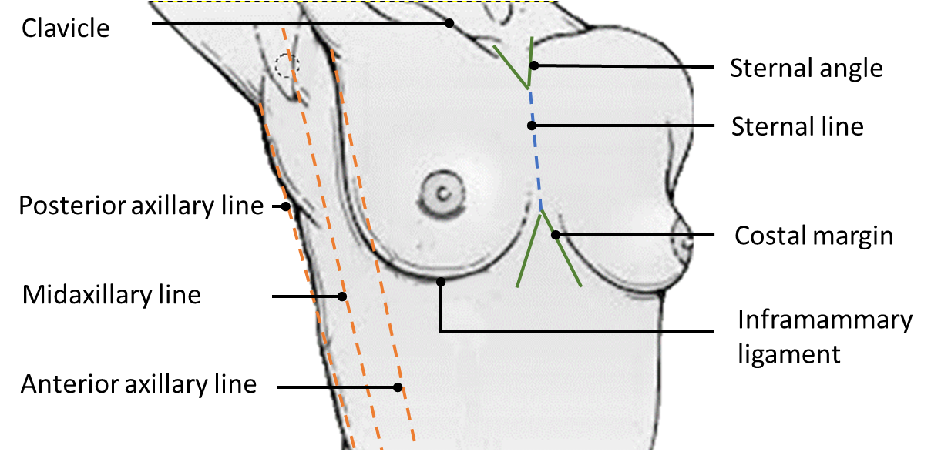

Slide 6
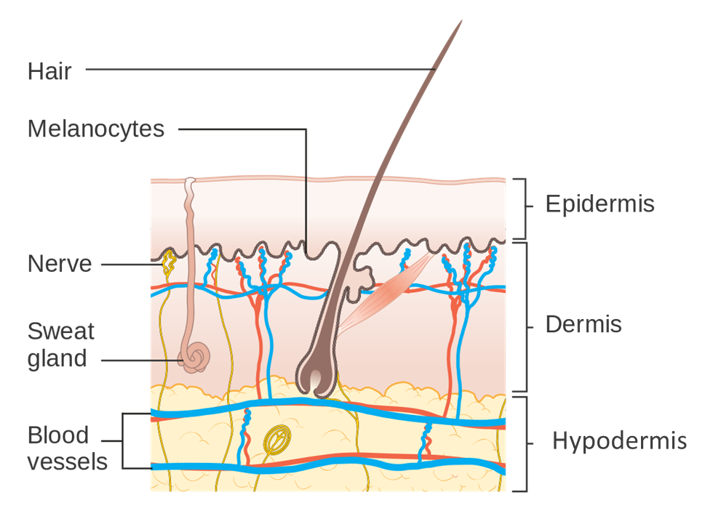

Slide 7
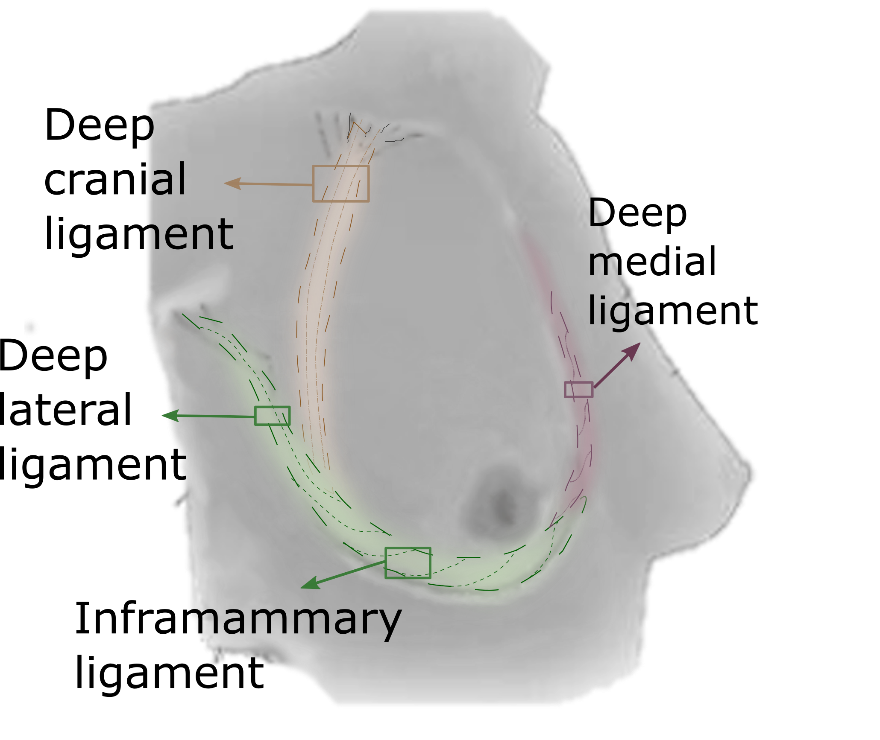
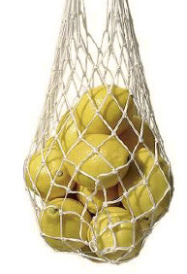
a)
b)

Slide 8
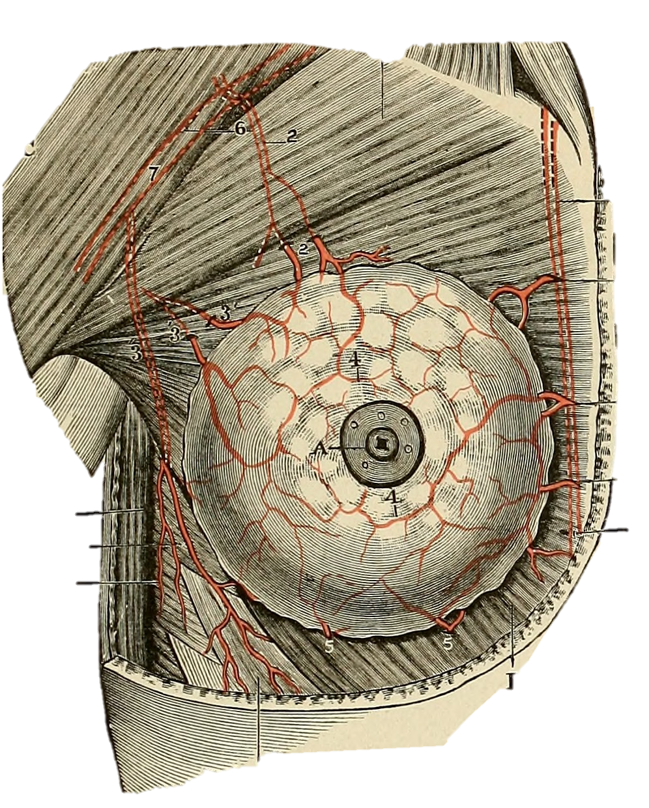
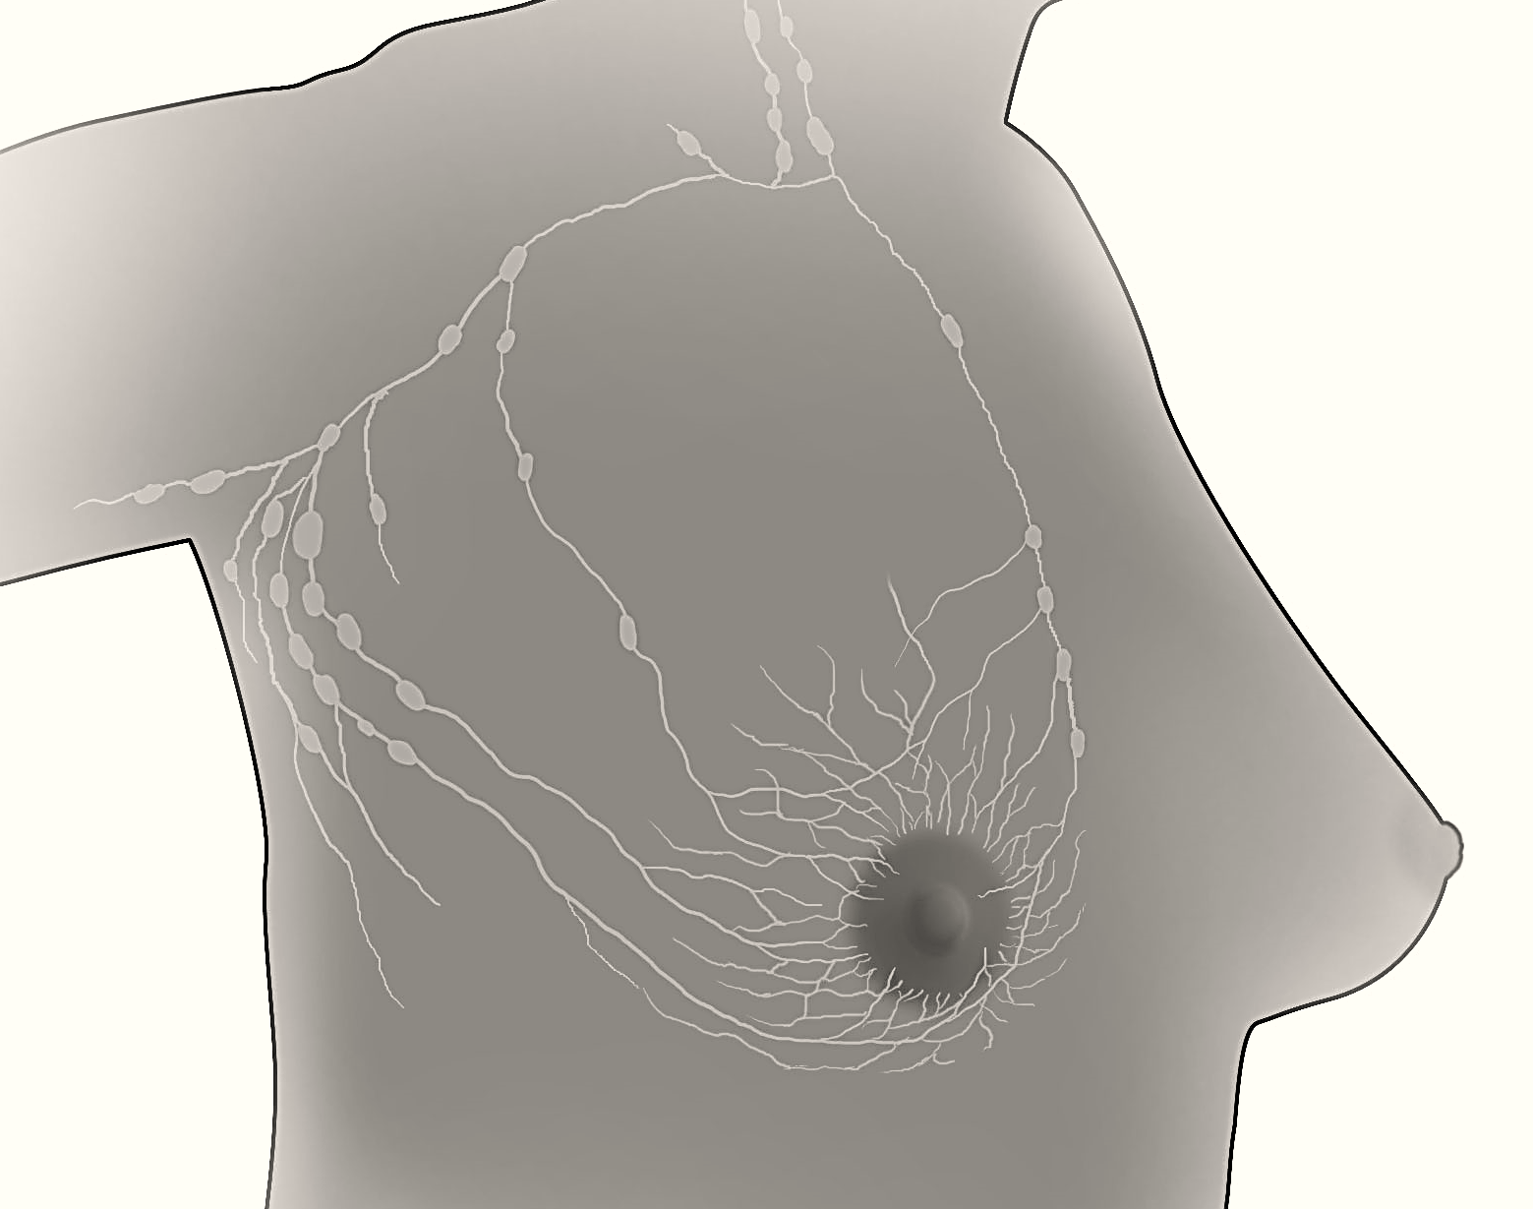
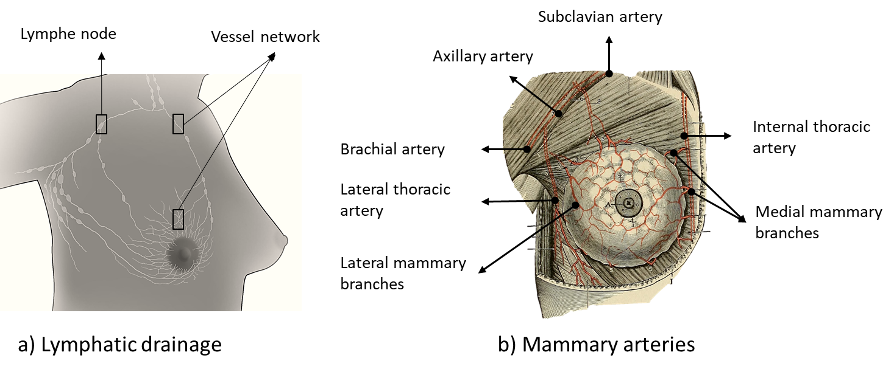
Subclavian artery
Lymphe node
Vessel network
Axillary artery
Internal thoracic
artery
Brachial artery
Lateral thoracic
artery
Medial mammary
branches
Lateral mammary
branches
a) Lymphatic drainage
b) Mammary arteries

